Slide 1


┌
LDSA Corp.
Database and Supply Chain Information Systems
┌
Group 3:
Divya Krishnan

Slide 2
Overview of Presentation
1
Overview and Value
2
Database Design and Implementation
3
Database Creation
4
Database SQL Statements, Reports, and Forms
5
Challenges and Conclusion

Slide 3
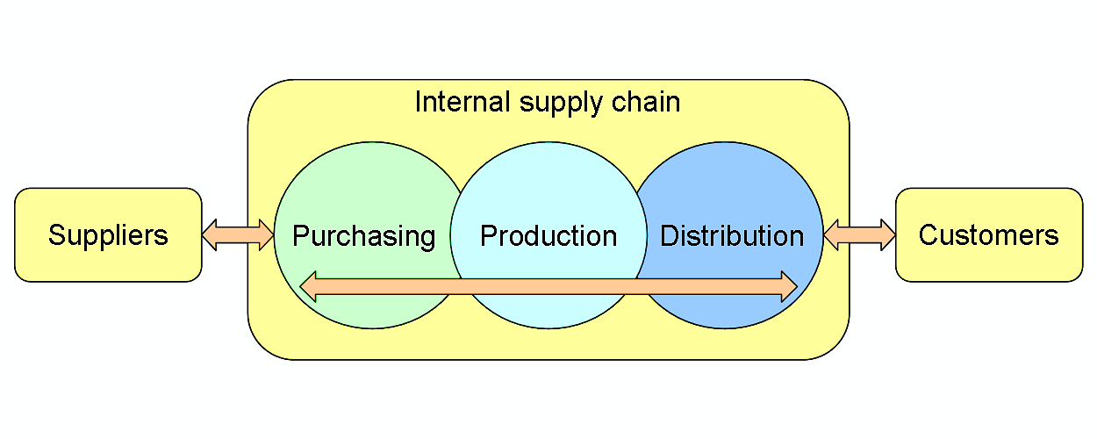
Section 1 - Introduction
Our value proposition – a database and information system targeted to create industry specific reporting.
This Photo by Unknown Author is licensed under CC BY-SA

Slide 4
Overview of Presentation
1
Overview and Value
2
Database Design and Implementation
3
Database Creation
4
Database SQL Statements, Reports, and Forms
5
Challenges and Conclusion

Slide 5
Preliminary Design
The most practical design included 10 basic entities.
These ten entities allows the firm to track order generation from supply to consumer delivery.
These entities prevent duplication and allow for a streamlined process:
Supplier – Provides the name of the supplier, their address, and number for contact.
Clothing Type – Unique TypeID, season, and gender.
Clothing – The unique supplier code, costPrice, TypeID, and materials.
Clothing Prices – Provides the price of each unit and the ClothingID attached to each.
Customer – All relevant customer data pertaining to the purchase.
OrderShipping – Unique address for delivery.
Orders – Links customer, shipping information, and the clothing type order by the customer.
Payment – Customer payment information.
CustomerOrderProduct – Customer’s order, the ClothingID, and quantity of purchase.
CustomerOrderDelivery – Provides tracking number to ensure fulfillment.

Slide 6
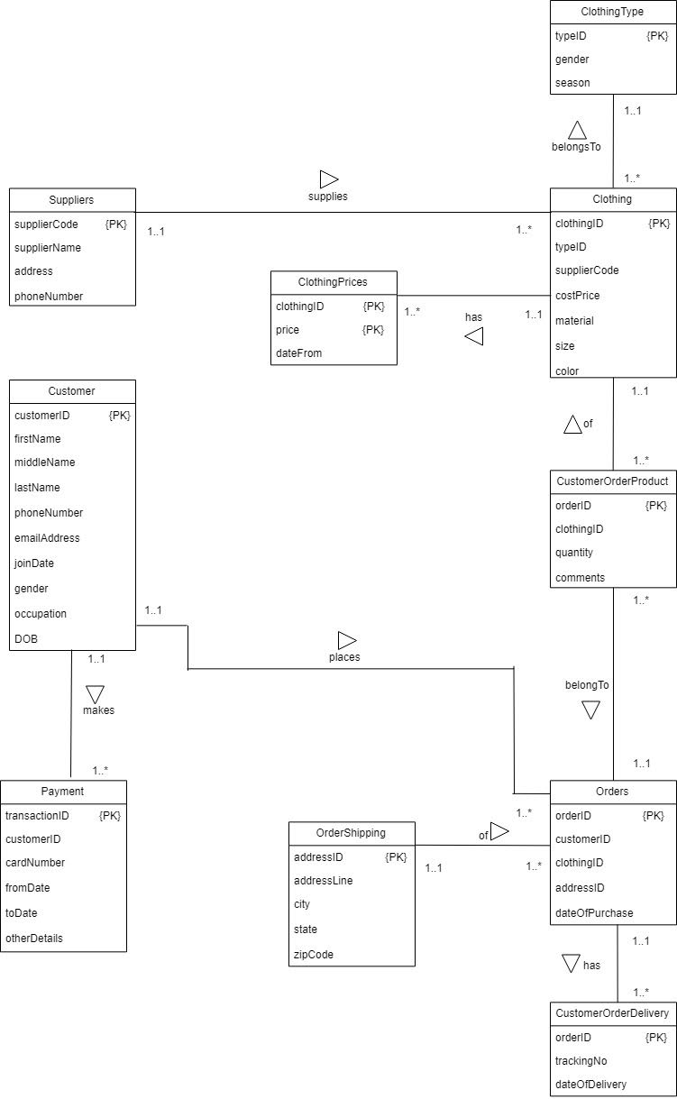
Entity Relationship Model
Notes:
Copy and Paste ER model; explain basics.

Slide 7
Relational Model
All relationships contained no observable transitive or derivable transitive functional dependencies and are therefore in 3NF.
Below are details the primary key and foreign keys, if they exist, for all entities in the ER Model.
ClothingType (typeID {PK}, gender, season).
Supplier (supplierCode {PK}, supplierName, address, phoneNumber).
Clothing (clothingID {PK}, typeID, supplierCode, costPrice, material, size, color).
ClothingPrices (clothingID, price {PK}, dateFrom).
Customer (customerID {PK}, firstName, middleName, lastName, phoneNumber, emailAddress, joinDate, gender, occupation, DoB).
OrderShipping (addressID {PK}, addressLine, city, state, zipCode).
Orders (orderID {PK}, customerID. clothingID, addressID, dateOfPurchase)
Payment (transactionID {PK}, orderID, cardNumber, fromDate, toDate, otherDetails)
CustomerOrderProduct (customerOrderID {P.K.}, orderID, clothingID, Quantity, comments)
CustomerOrderDelivery (trackingNo {PK}, orderID, dateOfDelivery)
Notes:
Fix FK notes

Slide 8
Overview of Presentation
1
Overview and Value
2
Database Design and Implementation
3
Database Creation
4
Database SQL Statements, Reports, and Forms
5
Challenges and Conclusion

Slide 9
Database Creation - SQL Statements
CREATE TABLE Clothing
(ClothingID char(5) PRIMARY KEY,
TypeID char(3),
SupplierCode char(4),
CostPrice decimal(10,2),
Material varchar(10),
Size varchar (15),
Color varchar(15),
Foreign Key (TypeID) references ClothingType (TypeID),
Foreign Key (SupplierCode) references Supplier (SupplierCode)
);
Notes:
Add creation statements using SQL; illustrate through word copy and paste

Slide 10
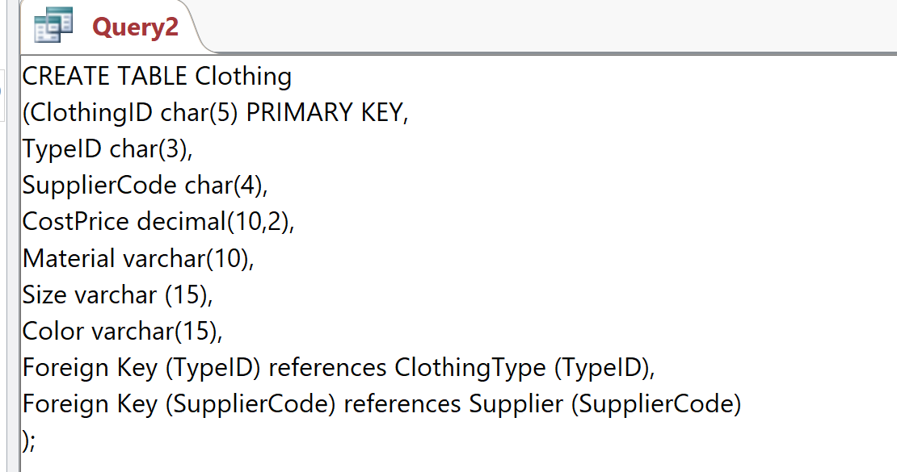
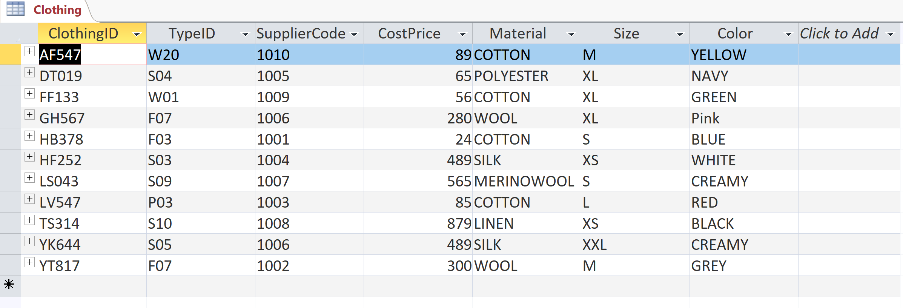
Database Creation SQL Result
Notes:
Add Snippet of Access database snippet of creation and populating tables.

Slide 11
Overview of Presentation
1
Overview and Value
2
Database Design and Implementation
3
Database Creation
4
Database SQL Statements, Reports, and Forms
5
Challenges and Conclusion

Slide 12
Relevant SQL Statements and Reports
Reports
Sales
Yearly sales report, trend analysis report
Revenue, Cost and Margin analysis report
Finance
Notes:
Add two slides or relevant SQL statements to illustrate database usage

Slide 13
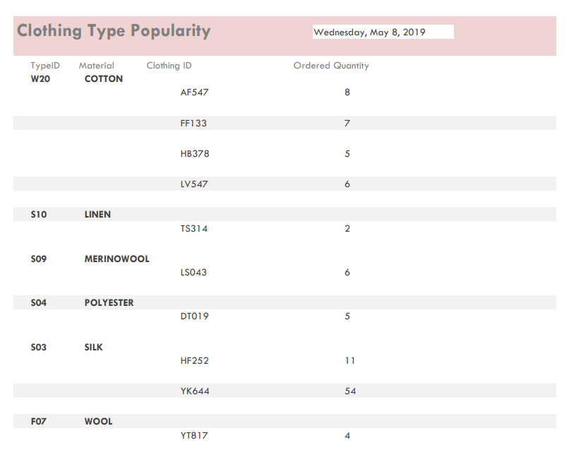
Relevant SQL Statements and Reports
Notes:
Add two slides or relevant SQL statements to illustrate database usage (Add picture on 1 slide, add form on second slide)

Slide 14
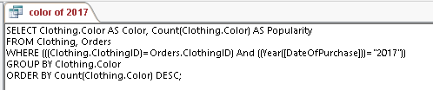
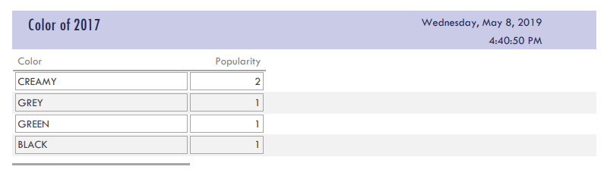
Relevant SQL Statements and Reports
Notes:
Add two slides or relevant SQL statements to illustrate database usage (Add picture on 1 slide, add form on second slide)

Slide 15
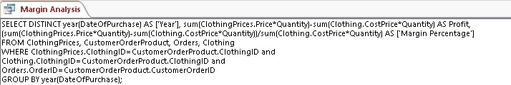
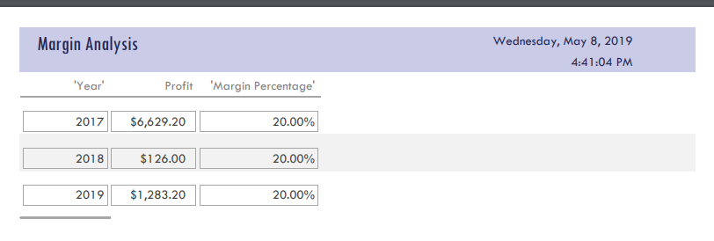
Relevant SQL Statements and Reports
Notes:
Add two slides or relevant SQL statements to illustrate database usage (Add picture on 1 slide, add form on second slide)

Slide 16
Overview of Presentation
1
Overview and Value
2
Database Design and Implementation
3
Database Creation
4
Database SQL Statements, Reports, and Forms
5
Challenges and Conclusion

Slide 17
Challenges and Conclusions
Scalability is a difficult concept to comprehend at the outset of a project.
Access, as a database management tool, provides a good platform for the limited scope of the project, but having a larger number of tables, relationships, queries, forms…etc., may make any database too nebulous.
However, Access’s interconnectivity with Microsoft Office suites provides a related environment that can be further enhanced with VBA.
Overall, our available software fit our project and helped to streamline the database creation portion of the project.

Slide 18
Thanks
Group 3

